Slide 1
Data Structures
Day - 5

Slide 2
What are they?
Organizing, managing and storing data is important as it enables easier access and efficient modifications. Data Structures help organize data in such a way that enables us to store collections of data, relate them and perform operations on them accordingly.
Python has implicit support for Data Structures which enable you to store and access data. These structures are called List, Dictionary, Tuple and Set.
Python allows its users to create their own Data Structures enabling them to have full control over their functionality.

Slide 3
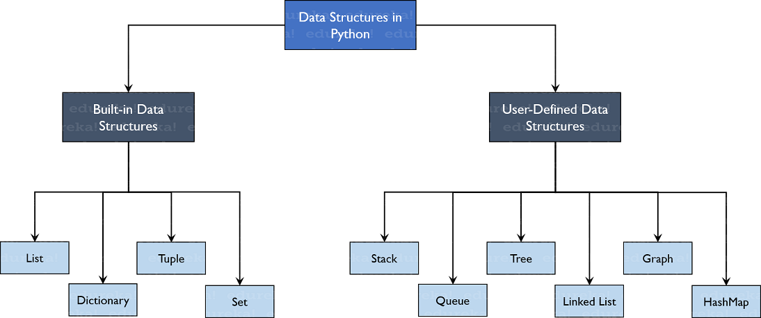
Data Structure in Python

Slide 4
Lists
Lists are used to store data of different data types in a sequential manner. There are addresses assigned to every element of the list, which is called as Index.
list_1 = [8, 8, ‘Python’, 5.6, True, [“New”, “List”, 77]]
List items are ordered, mutable/changeable, and allow duplicate values.
List items are indexed, the first item has index [0], the second item has index [1] and so on.
8
8
Python
5.6
True
[“New”, “List”, 77]
0
1
2
3
4
5

Slide 5
Creating Lists - Basic
thislist = ["apple", "banana", "cherry"]
thislist = list(("apple", "banana", "cherry"))
print(len(thislist))
print(type(thislist))

Slide 6
Accessing List
thislist = ["apple", "banana", "cherry"]
Indexing
print(thislist[1])
print(thislist[-1])
Slicing
print(thislist[2:5])
print(thislist[:4])
print(thislist[2:])

Slide 7
Changing Items
thislist = ["apple", "banana", "cherry"]
thislist[1] = "blackcurrant“
thislist[1:3] = ["blackcurrant", "watermelon"]
The length of the list will change when the number of items inserted does not match the number of items replaced.

Slide 8
Adding Items
thislist = ["apple", "banana", "cherry"]
thislist.insert(2, "watermelon")
thislist.append("orange")
tropical = ["mango", "pineapple", "papaya"]
thislist.extend(tropical)

Slide 9
Removing Items
thislist = ["apple", "banana", "cherry"]
thislist.remove("banana")
thislist.pop(1)
del thislist[0]
del thislist
thislist.clear()

Slide 10
Looping Through List
thislist = ["apple", "banana", "cherry"]
for x in thislist: print(x)
for i in range(len(thislist)): print(thislist[i])
i = 0
while i < len(thislist): print(thislist[i]) i = i + 1

Slide 11
Sorting
thislist = ["banana", "Orange", "Kiwi", "cherry"]
thislist.sort()
thislist.sort(reverse = True)
thislist.sort(key = str.lower)
thislist.reverse()

Slide 12
Copying List
You cannot copy a list simply by typing list2 = list1, because: list2 will only be a reference to list1, and changes made in list1 will automatically also be made in list2.
thislist = ["apple", "banana", "cherry"]
mylist = thislist.copy()
mylist = list(thislist)

Slide 13
Some More Methods
fruits = ['apple', 'banana', 'cherry’]
fruits.count("cherry")
fruits.index("cherry")

Slide 14
Tuples
Tuples are same as list in storing data except that they cannot be changed.
tup = (8, 8, ‘Python’, 5.6, True, [“New”, “List”, 77])
Tuple items are ordered, unchangeable and allow duplicate values.
thistuple = ("apple", "banana", "cherry")
thistuple = ("apple",)
thistuple = tuple(("apple", "banana", "cherry"))

Slide 15
Accessing and Changing Elements
Elements of tuples can be accessed the same as list.
As tuples are immutable, we covert them into list do the changes and convert them again.
Or we can concatenate two tuples;
thistuple = ("apple", "banana", "cherry") y = ("orange",) thistuple += y

Slide 16
Unpacking Tuples
When we create a tuple, we normally assign values to it. This is called "packing" a tuple but, in Python, we are also allowed to extract the values back into variables. This is called "unpacking“.
fruits = ("apple", "banana", "cherry")
green, yellow, red = fruits
fruits=("apple", "mango", "papaya", "pineapple", "cherry")
green, *tropic, red = fruits

Slide 17
Sets
A set is a collection which is both unordered and unindexed.
set_1 = {8, 8, ‘Python’, 5.6, True, [“New”, “List”, 77]}
Sets items are unordered, immutable and do not allow duplicates.
thisset = {"apple", "banana", "cherry"}
thisset = set(("apple", "banana", "cherry"))

Slide 18
Accessing Elements
You cannot access items in a set by referring to an index or a key.
But you can loop through the set items using a for loop or ask if a specified value is present in a set, by using the in keyword.
thisset = {"apple", "banana", "cherry"}
for x in thisset: print(x)
print("banana" in thisset)

Slide 19
Adding Items to Set
Once a set is created, you cannot change its items, but you can add new items.
thisset = {"apple", "banana", "cherry"}
thisset.add("orange")
tropical = {"pineapple", "mango", "papaya"}
thisset.update(tropical)

Slide 20
Removing Items
thisset = {"apple", "banana", "cherry"}
thisset.remove("banana")
If the item to remove does not exist, remove() will raise an error.
thisset.discard("banana")
If the item to remove does not exist, discard() will NOT raise an error.
thisset.pop()
Sets are unordered, so when using the pop() method, you do not know which item that gets removed.
thisset.clear()
del thisset

Slide 21
Looping
Looping in sets is same as lists.
thisset = {"apple", "banana", "cherry"} for x in thisset: print(x)

Slide 22
Joining Sets
There are several ways to join two or more sets in Python.
set1 = {"a", "b" , "c"} set2 = {1, 2, 3}
set3 = set1.union(set2)
set1.update(set2)
Both union() and update() will exclude any duplicate items.

Slide 23
Joining Sets (Intersection)
The intersection_update() method will keep only the items that are present in both sets.
x = {"apple", "banana", "cherry"} y = {"google", "microsoft", "apple"} x.intersection_update(y)
The intersection() method will return a new set, that only contains the items that are present in both sets
z = x.intersection(y)

Slide 24
Joining Sets (Symmetric Difference)
x = {"apple", "banana", "cherry"} y = {"google", "microsoft", "apple"}
The symmetric_difference_update() method will keep only the elements that are NOT present in both sets.
x.symmetric_difference_update(y)
The symmetric_difference() method will return a new set, that contains only the elements that are NOT present in both sets.
z = x.symmetric_difference(y)

Slide 25
Thank You

